Slide 1
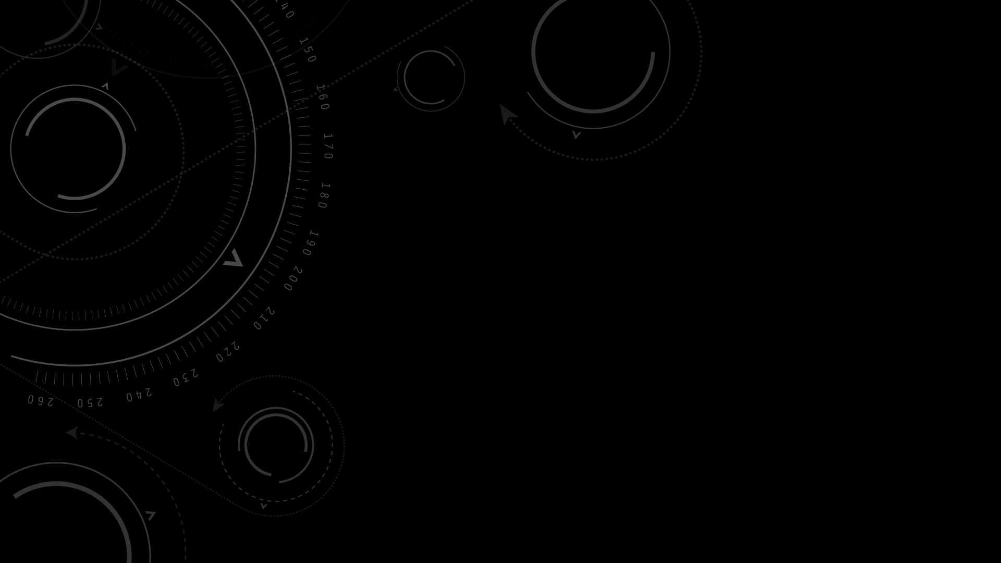
Weak Gravitational Lensing
ZehaoJin Department Of Physics, UIUC 4/11/2019 PHYS 403 Journal Club Presentation

Slide 2
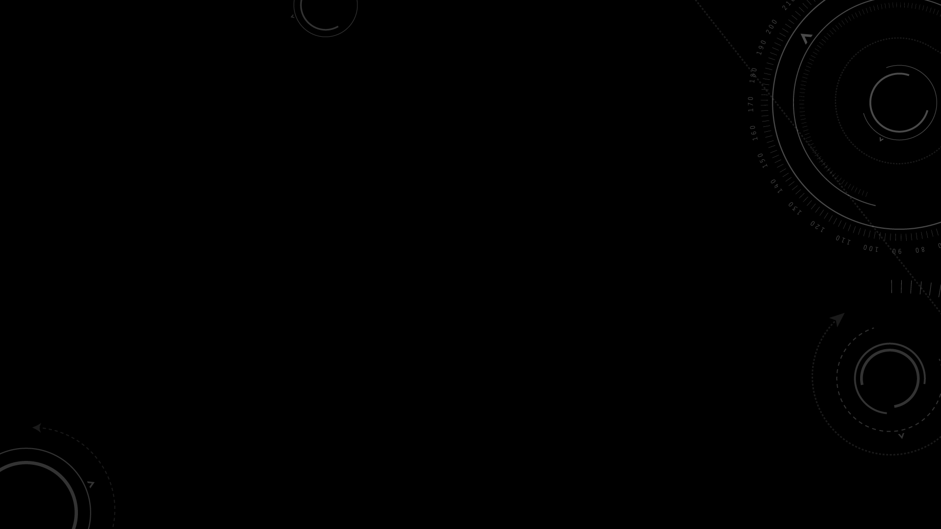

Gravitational Lensing Theory
Einstein’s General Relativity--Light “bends”
due to gravitational field.
Massive objects act as “lens”.
Credit: European Southern Observatory (ESO)

Slide 3
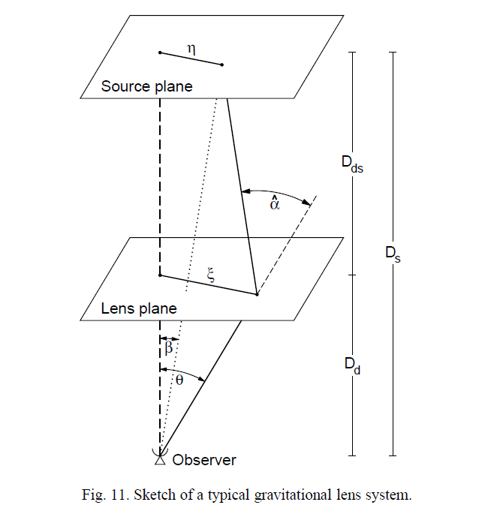
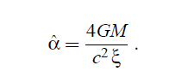
Gravitational Lensing Theory
GR gives the deflection angle
Somewhat like optical convex lens, but different
maximum deflection of light that passes closest to its center.
minimum deflection of light that travels furthest from its center.
Therefore we have Weak Lensing and Strong Lensing
Credit: Weak Gravitational Lensing by Matthias Bartelmann and Peter Schneider
Phys.Rept.340:291-472,2001

Slide 4
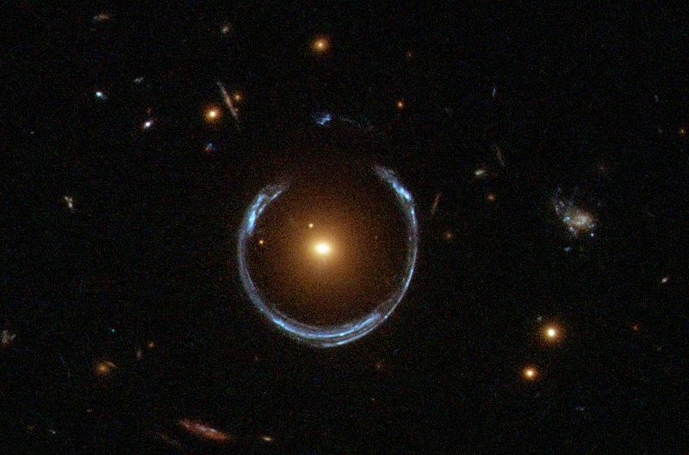
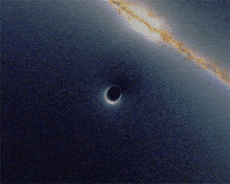
Strong Lensing
Strong enough to produce multiple images, arcs, or even Einstein rings.
A bright red galaxy distorted the light from a distant blue galaxy.
Simulation of a black hole passing in front of a background galaxy.
Image Credit: NASA, Hubble Space Telescope

Slide 5
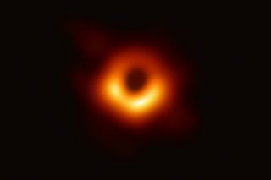
Strong Lensing
Credit: Event Horizon Telescope

Slide 6
Weak Lensing
“Weak” – distortions of background sources are much smaller
Statistical – can only be detected by analyzing large numbers of sources in a statistical way to find coherent distortions of only a few percent.
Magnification and distortion (“shear”) effect
Shear measurements yield much better results

Slide 7
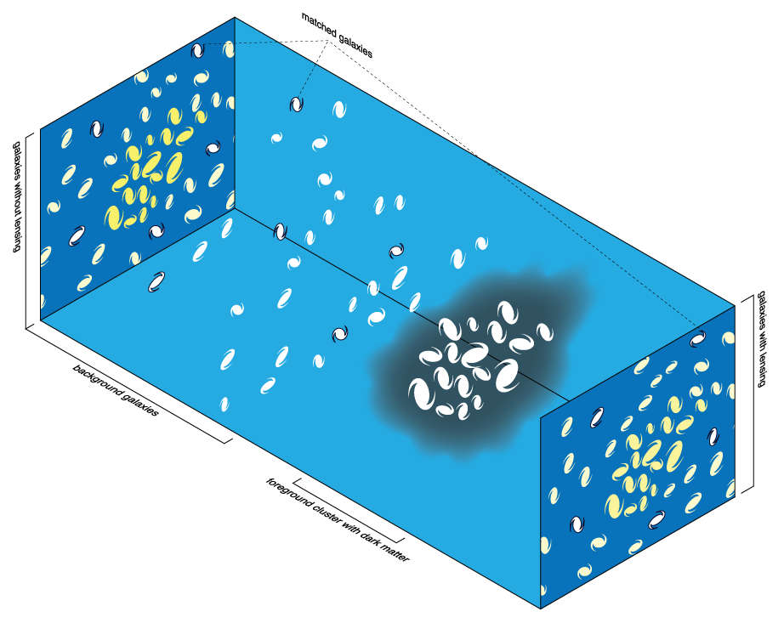
Weak Lensing – Shear
Should have averaged Tangential Shear
No Cross shear.
Cross shear can be used to estimate
uncertainty of the measurement.
Credit: Wikipedia, by Michael Sachs

Slide 8
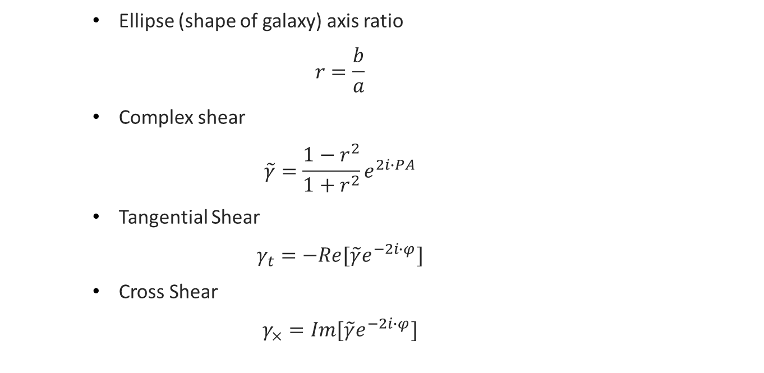
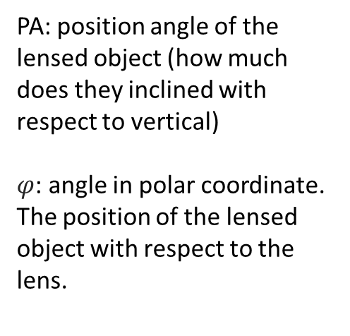
Weak Lensing – Tangential Shear
Ellipse (shape of galaxy) axis ratio
$$r=\frac{b}{a}$$
Complex shear
$$\tilde{γ}=\frac{1−r^{2}}{1+r^{2}}e^{2i∙PA}$$
Tangential Shear
$$γ_{t}=−Re[\tilde{γ}e^{−2i∙φ}]$$
Cross Shear
$$γ_{×}=Im[\tilde{γ}e^{−2i∙φ}]$$
PA: position angle of the lensed object (how much does they inclined with respect to vertical)
$φ$: angle in polar coordinate. The position of the lensed object with respect to the lens.

Slide 9
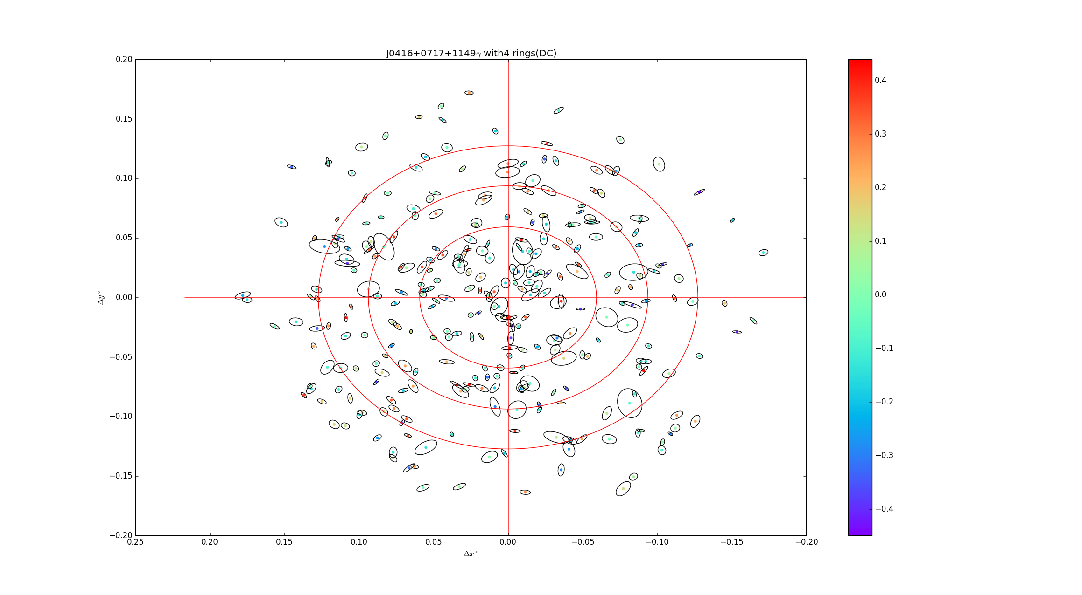
Weak Lensing – Tangential Shear
Data from: VLA

Slide 10
Weak Lensing – Challenges
Fundamental problem: Intrinsic shape of galaxies
galaxies are NOT circular!
their measured ellipticity is a combination of their intrinsic ellipticity and the gravitational lensing shear (3-300 : 1)
Need tons of data so that the intrinsic ellipticity averages to circular.
“Deconvolution”
Atmospheric seeing will cause a smear effect on objects observed, making small objects more “round”
Telescope’s point spread function(PSF) adds a small level of ellipticity to objects observed to compensate atmospheric seeing. But such correction can in fact mimic a true lensing signal

Slide 11
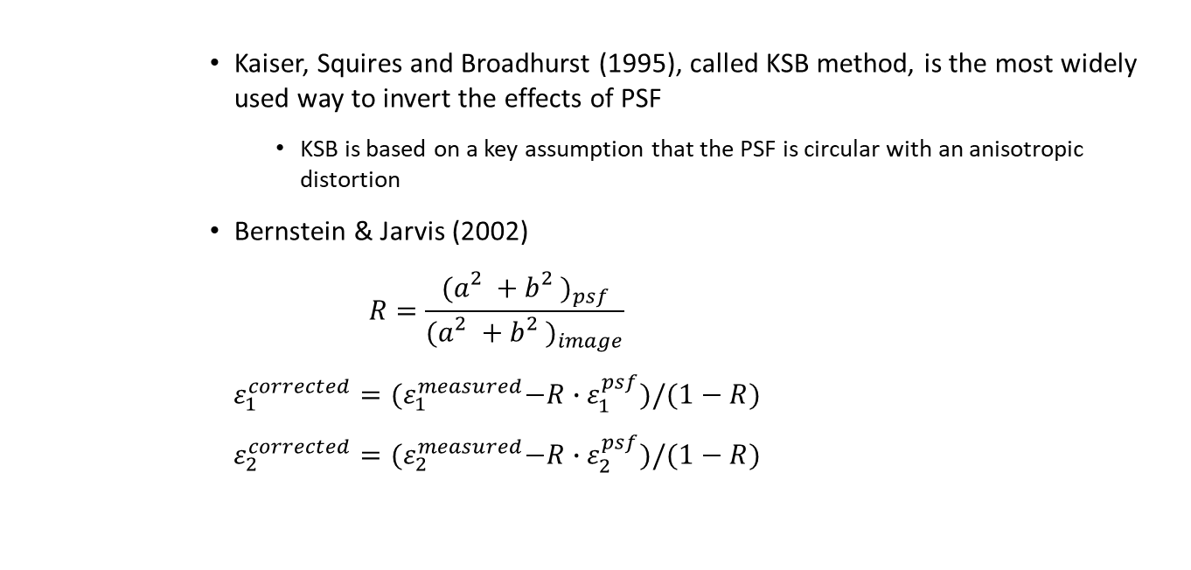
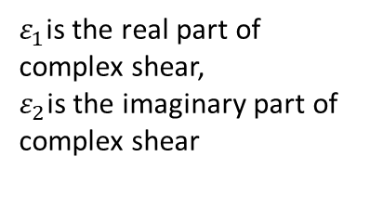
Weak Lensing – Deconvolution
Kaiser, Squires and Broadhurst (1995), called KSB method, is the most widely used way to invert the effects of PSF
KSB is based on a key assumption that the PSF is circular with an anisotropic distortion
Bernstein & Jarvis (2002)
$$R=\frac{{(a_{}^{2}+b_{}^{2})}_{psf}}{{(a_{}^{2}+b_{}^{2})}_{image}}$$
$$ε_{1}^{corrected}={(ε}_{1}^{measured}−R∙ε_{1}^{psf})/(1−R)$$
$$ε_{2}^{corrected}={(ε}_{2}^{measured}−R∙ε_{2}^{psf})/(1−R)$$
$ε_{1}$is the real part of complex shear,
$ε_{2}$is the imaginary part of complex shear

Slide 12
Weak Lensing – Deconvolution
Kaiser, Squires and Broadhurst (1995), called KSB method, is the most widely used way to invert the effects of PSF
KSB is based on a key assumption that the PSF is circular with an anisotropic distortion
Bernstein & Jarvis (2002)
$$R=\frac{{(a_{}^{2}+b_{}^{2})}_{psf}}{{(a_{}^{2}+b_{}^{2})}_{image}}$$
$$ε_{1}^{corrected}={(ε}_{1}^{measured}−R∙ε_{1}^{psf})/(1−R)$$
$$ε_{2}^{corrected}={(ε}_{2}^{measured}−R∙ε_{2}^{psf})/(1−R)$$
$ε_{1}$is the real part of complex shear,
$ε_{2}$is the imaginary part of complex shear

Slide 13
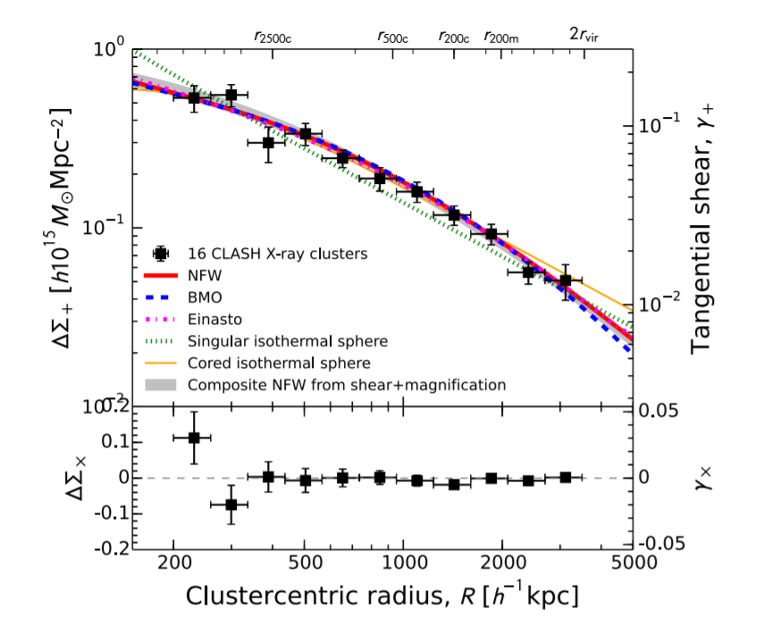
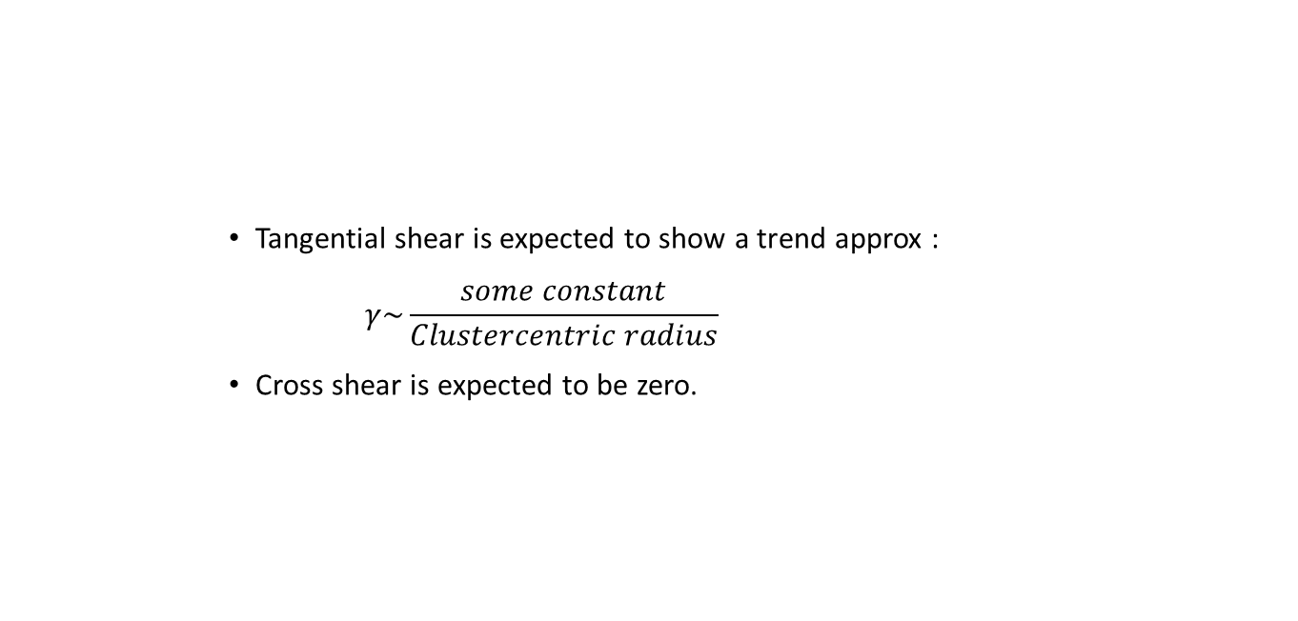
Weak Lensing – Results
Tangential shear is expected to show a trend approx :
$$γ\sim \frac{some constant}{Clustercentric radius}$$
Cross shear is expected to be zero.
Credit: CLASH: WEAK-LENSING SHEAR-AND-MAGNIFICATION ANALYSIS OF 20 GALAXY CLUSTERS, Zitrin et al.

Slide 14
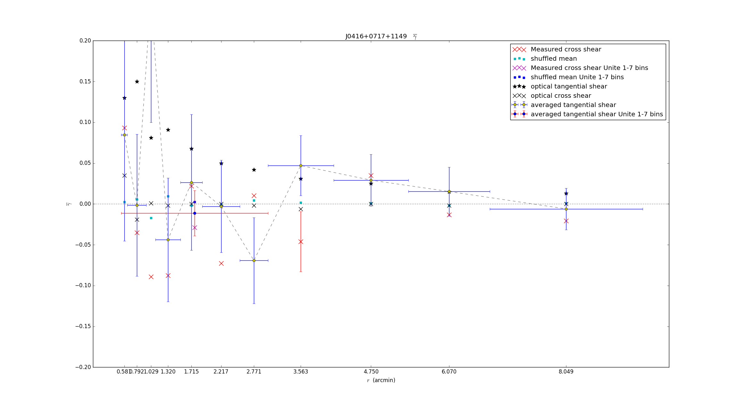
Weak Lensing – Results
VLA is a radio telescope
Larger primary beam, lots of data
are not so unresolved for weak
lensing
Radio telescope observes further
galaxies
→younger galaxies → more elliptical galaxies →bigger intrinsic ellipticity
Huge error bar
Data from VLA

Slide 15
Weak Lensing – Products
Statistical property of shear profile (Gradient of averaged tangential shear)
→ statistical property (mass density) of the lens.
Fit shear profile into mass models.
The Navarro–Frenk–White (NFW) profile one of the most commonly used model profiles for dark matter halos.

Slide 16
References
Weak Gravitational Lensing, Matthias Bartelmann and Peter Schneider,Phys.Rept.340:291-472,2001
Bernstein & Jarvis (2002)
CLASH: Weak-lensing Shear-and-magnification Analysis Of 20 Galaxy Clusters, Zitrin et al.

